Slide 1
Maijin
What is it?
Notes:
Introduction – Simple, and great!

Slide 2
What is Maijin?
Maijin is a GoAnimate BootUp by BGR2 and Pizaer
Maijin uses Grounded v1 for using Go:4Schools.
Maijin is Free to use and easy to setup!(Maijin can be also used directly.)
Maijin is safe to use and saves your characters and more!
Maijin is not associated with GoAnimate/Vyond.
Maijin is written in Node for easy use!

Slide 3
How to use?
First,Extract the zip file that you downloaded from GitHub.
Second,open the folder,than goto main-bat folder. Than run the bat. File that you saw. It will open Chromium.
Third,If you want to use it directly,Go to Slide 4 for more.

Slide 4
How to use?(Directly)
Firstly. Do C:\Users\USERNAMEHERE\Downloads\maijin-main\go-ezload than run those commands in order
npm install
npm run

Slide 5
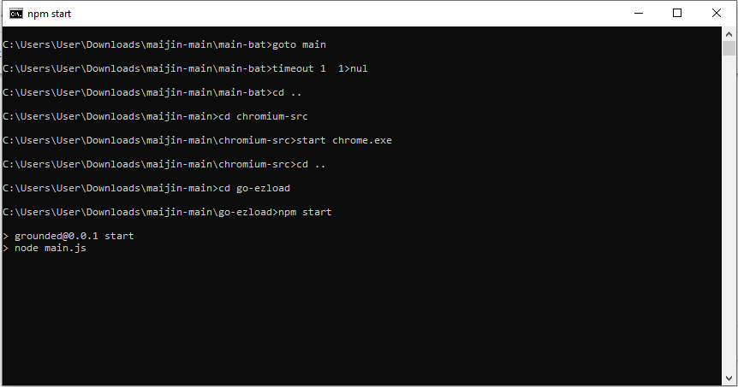
It will look like this,

Slide 6
To-Do
Need to fix ‘’Add Scene’’ issue
Fix SWF issues with go_full.
We think we fixed other issues with go_full swf file

Slide 7
Thats all!
Thank you for choosing Maijin,We are not connected with Vyond/GoAnimate.
-BGR2 08/20/2022 19:48

